Slide 1
Collaborative Platform Version 6.0
Team Members
Mandiel Lastra (Developer)
Michael Machin (Developer)

Slide 2
Problem
Current students lack a reliable source for answering questions related to their classes or projects in a timely manner.
Students may rely on several sources, often unreliable, inaccurate, and incomplete.
There exists a difficulty matching the right subject matter expert to the right question
Professionals in the field lack an accessible way of being able to mentor students.

Slide 3
Problem
Solution
Synchronization issue when users join a videoconference
Difficult interaction with the system
Lack of basic functionalities
Ability of users joining a conference after it has started
Improve usability of the system
Provide users with new features.

Slide 4
Problem
Solution
List of domains have to be populated by administrator
Questions can be assigned to mentors who are out of office
Questions stay assigned indefinitely regardless of priority
Questions are not assigned evenly
The same questions will be asked over and over
The mentor has to try to find the question in their queue when they receive it
Prospective mentors are able to suggest a domain.
Track mentors who are out of office and stop assigning questions to them
Assign questions to new mentors when the question runs out of time
Assign questions to mentors using round robin
Allow users to look up old questions.
Send the information, and link, of the ticket in the email.

Slide 5
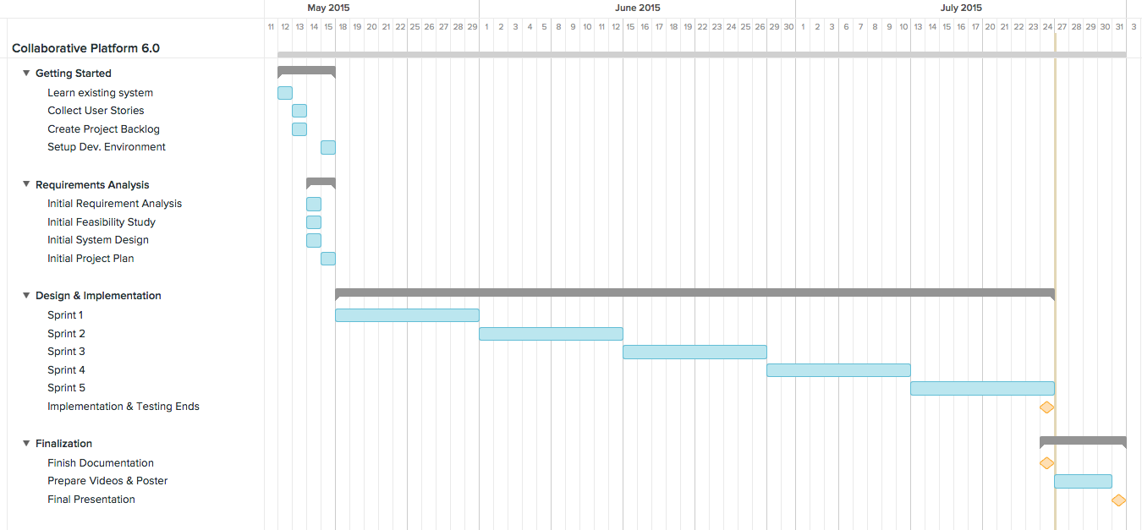
Project Management

Slide 6
Implemented User Stories
Allow users to turn their webcam on/off
Bug: Allow for users to register
Bug: Allow users to reset their password using the ‘Forgot Password’ option
Allow users registered by an administrator to change their password
Allow users to edit a video conference’s information
Allow users to join a conference without synchronization problems
Provide users with a second screen sharing window
Allow users to have a robust video conference room
Provide users with a chat feature
Allow users to join a conference and receive both screens if shared
Allow users to invite others by name when creating or editing a conference
Allow users to access Past/Canceled Video Conferences
Improve usability of the system

Slide 7
Implemented User Stories
Do not auto assign tickets to unavailable mentors
Send an email to the mentor signifying their unavailable status
Mentors on list are selected by round robin in domain
Tickets are reassigned after a set time of no mentor response
Bug: Ttickets can not have an uploaded file
Set mentors as unavailable upon receiving an Out of Office reply
Reassign tickets that were assigned to an unabailable mentor.
Allow mentor to reject a ticket from their email.
Allow the system admin to set and change reassign rules
Send information of ticket through email
Emails sent throught the system are validated
Allow mentors to remove themselves from the away list
Allow the system admin to manage away mentors.
Allow system adminr to add to away list using the user’s name and autocomplete
Bug: Personal mentors are not being registered correctly
Improve usability of the system

Slide 8
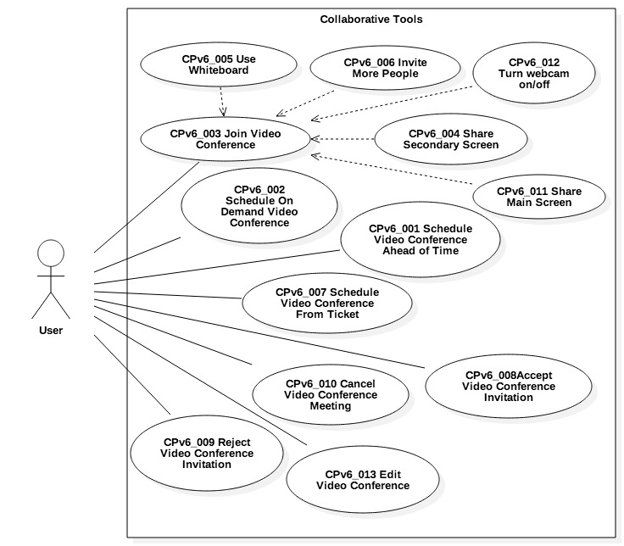
Use Cases

Slide 9
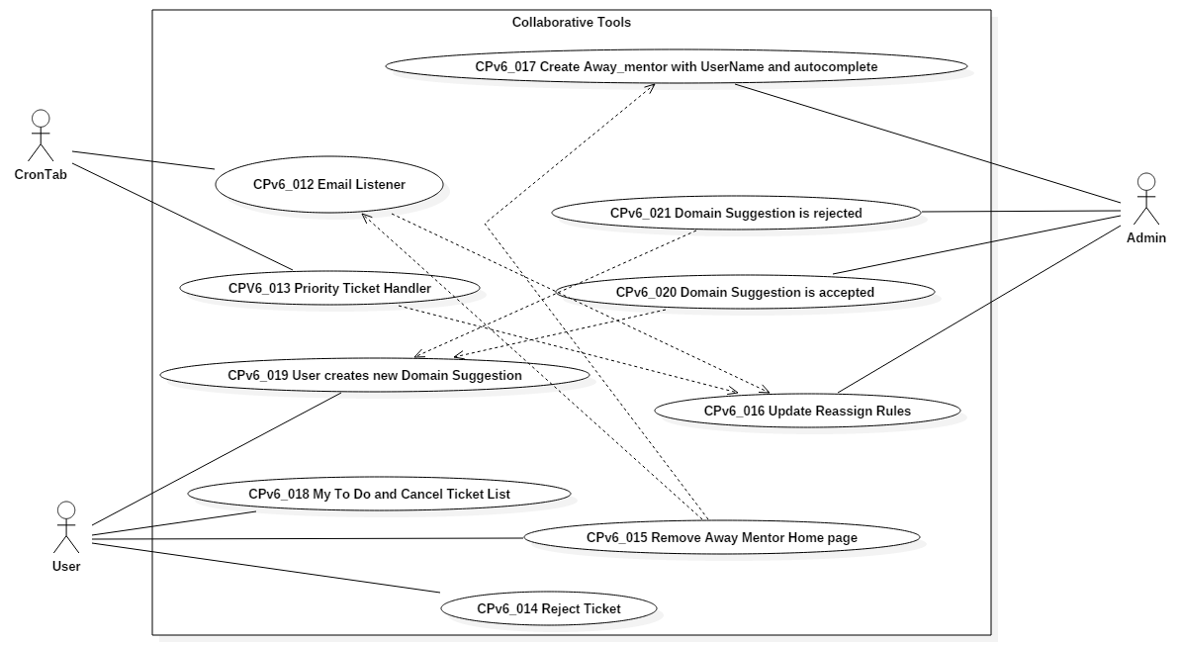
Use Cases

Slide 10
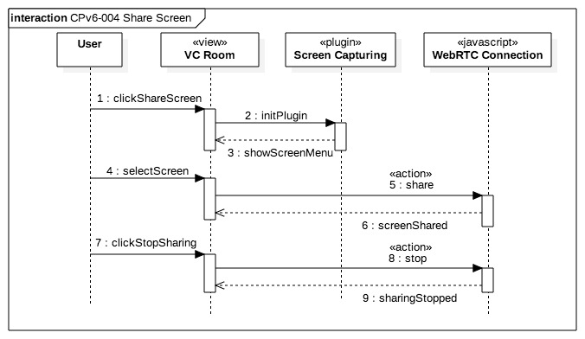
Sequence Diagrams

Slide 11
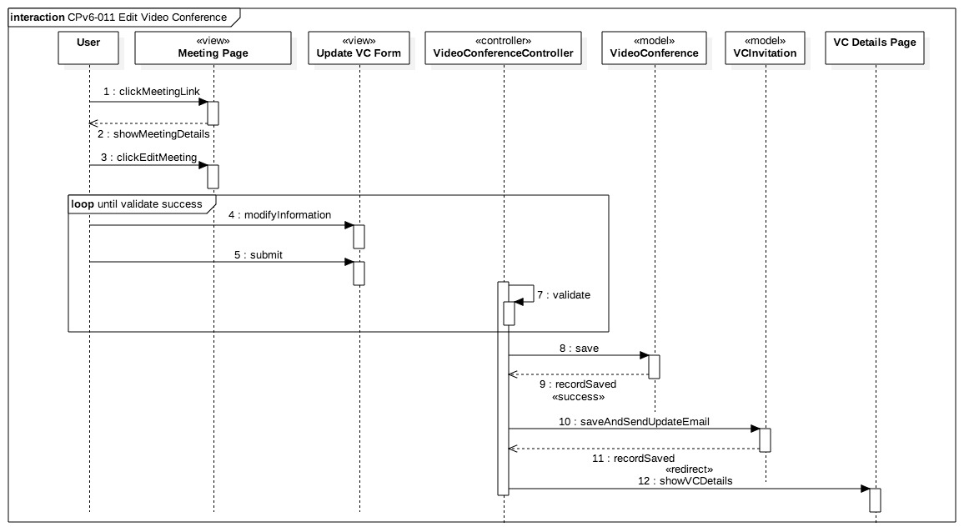
Sequence Diagrams

Slide 12
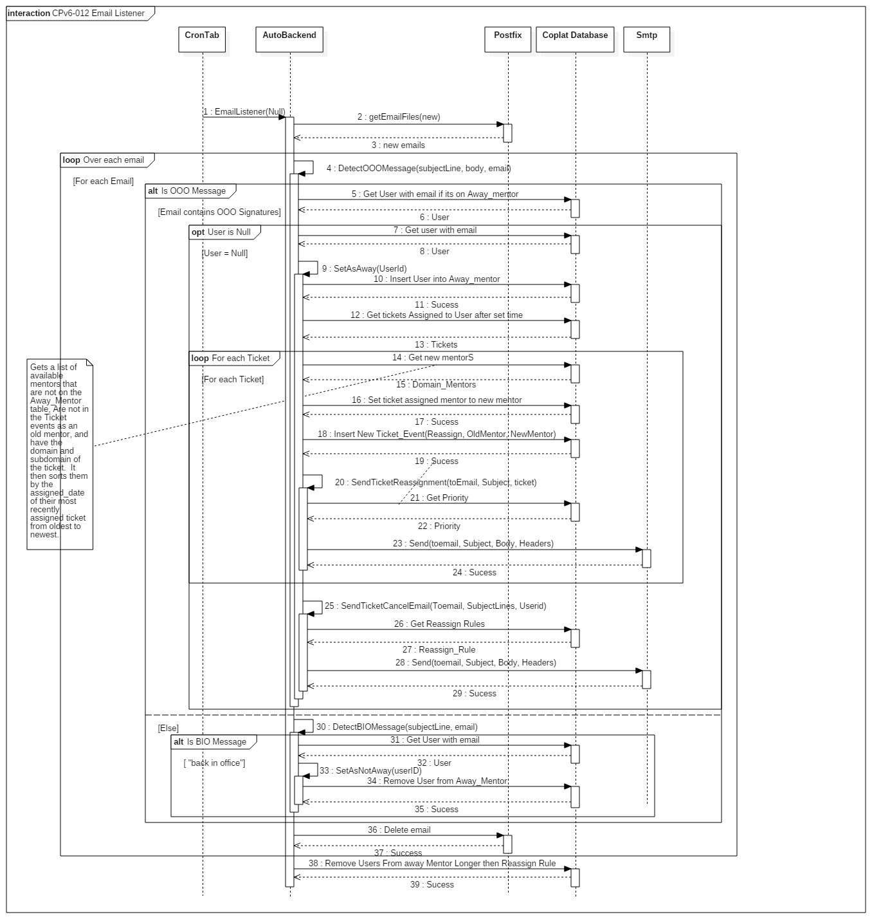
Sequence Diagrams

Slide 13
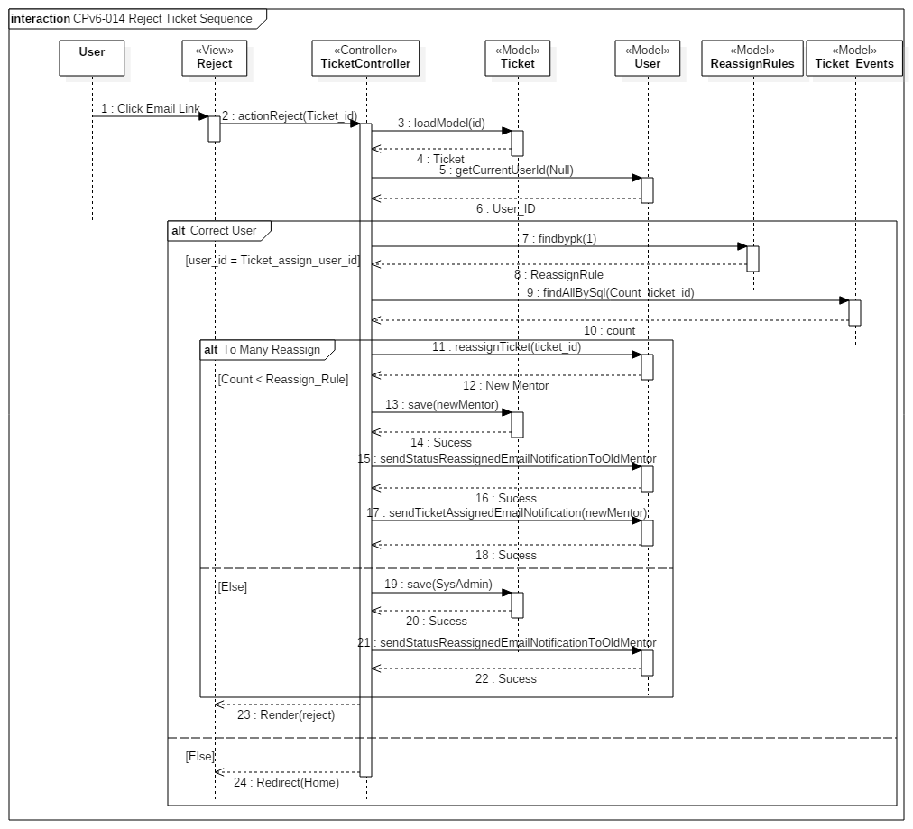
Sequence Diagrams

Slide 14
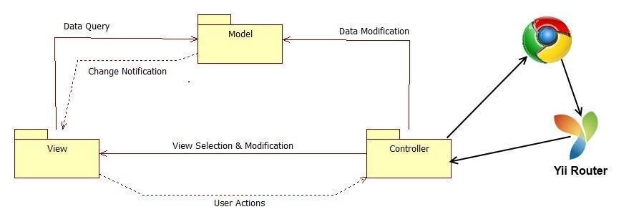
System Decomposition

Slide 15
System Deployment
Minimum Hardware
Minimum Software
Processor | 1.6 GHz
RAM | 256 MB
CPU op-model(s) | 32-bit
Database Server | MySql 5.5
Web Server | Apache 2.0
Server-side Scripting | PHP 5.5
Operating System | Windows, Linux, Mac OS

Slide 16
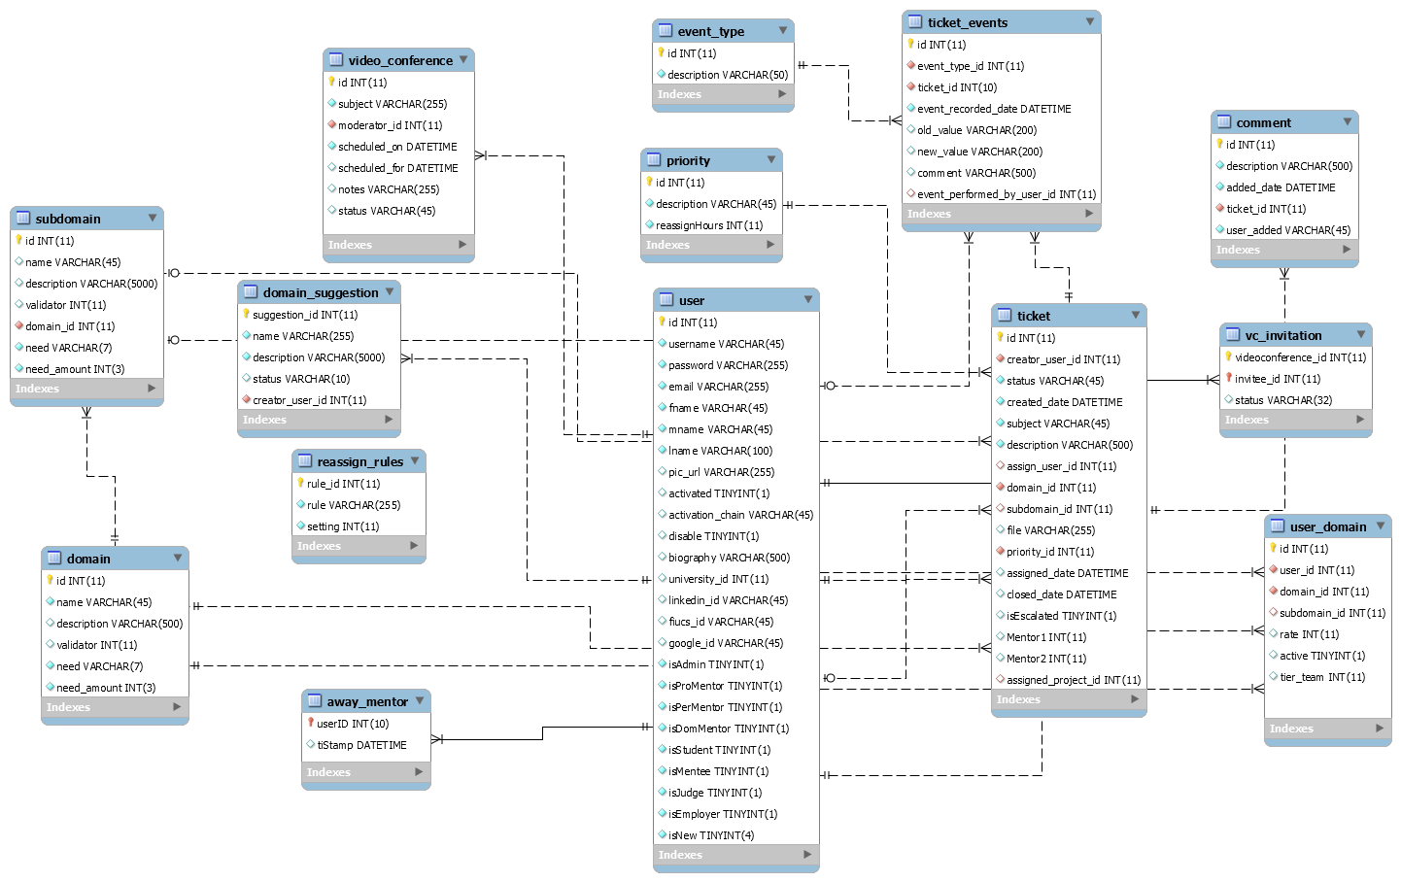
ER Diagram

Slide 17
Security/Privacy
Yii access control rules
Yii Cross-site scripting prevention
Password hashing
Secure registration process

Slide 18
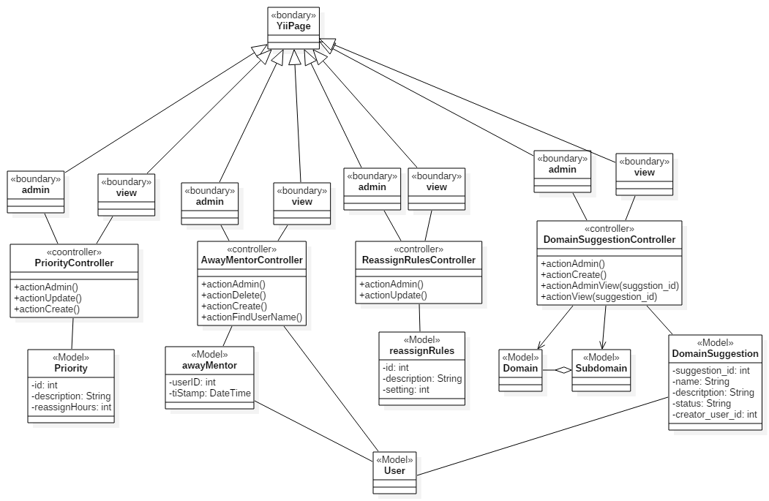
Minimal Class Diagram

Slide 19
Share Both Screens algorithm
User1:
Click on
‘Screen Sharing’->‘Share Screen’
2. Select screen to be shared
3. if(!rightScreenIsShared){
sendStreamIdToAllUsers();
shareScreenOnTheRight();
}
else {
shareSceenOnTheLeft();
}
User2:
Click on
‘Screen Sharing’->‘Share Screen’
2. Select screen to be shared
3. if(!rightScreenIsShared){
sendStreamIdToAllUsers();
shareScreenOnTheRight();
}
else {
shareSceenOnTheLeft();
}

Slide 20
Algorithm
Collect Emails sent to system
Check each email for “out of office” qualifiers
If email has out of office qualifiers find the user with email’s from address
If the email is attached to a user, add that user to the away_mentor table
Find all tickets assigned within “Reassign Rules hours
For each ticket:
Append the tickets subject to “subjects” string
Find a new appropriate mentor
Assign the ticket to a new mentor
Email the new mentor
Record the ticket event
Email the “out of office” mentor their tickets that have been reassign and notify them of being away.

Slide 21
Test Cases
Test Case ID | TC_CP_VCM_02 Video conference is edited
Test Objective | Test that a conference can be edited by the moderator
Precondition | 1. User is logged into the Collaborative Platform site. 2. User is on the "Video Conference" page or the "View Video Conference" page. 3. User has a video conference that was created by him/her
Steps: | 1. Click on "Edit" on the conference to be editted 2. Make necessary changes 3. Click on "Save"
Test Data | Subject: Integration Testing Date: 08/05/2015 Time: 11:00 am Invitee: Lastra, Mandiel Invitee 2: Machin, Michael
Expected Result | The invitations have been sent successfully sent
Actual Output | The invitations have been sent successfully sent
Test Case ID | TC_CP_VCM_02 Video conference invitation to user that is not registered
Test Objective | Test that an invitation cannot be sent to a user that is not registered in our system
Precondition | 1. User is logged into the Collaborative Platform site. 2. User is on the "Video Conference" page or the "View Video Conference" page. 3. User has a video conference that was created by him/her
Steps: | 1. Click on "Edit" on the conference to be editted 2. Make necessary changes 3. Click on "Save"
Test Data | Subject: Integration Testing Date: 08/05/2015 Time: 11:00 am Invitee: Smith, John
Expected Result | Smith, John does not appear in our records
Actual Output | Smith, John does not appear in our records

Slide 22
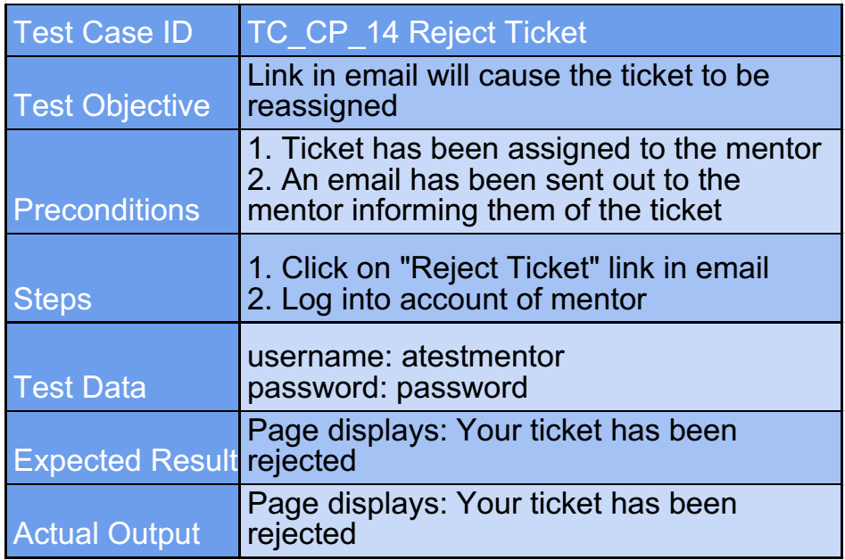
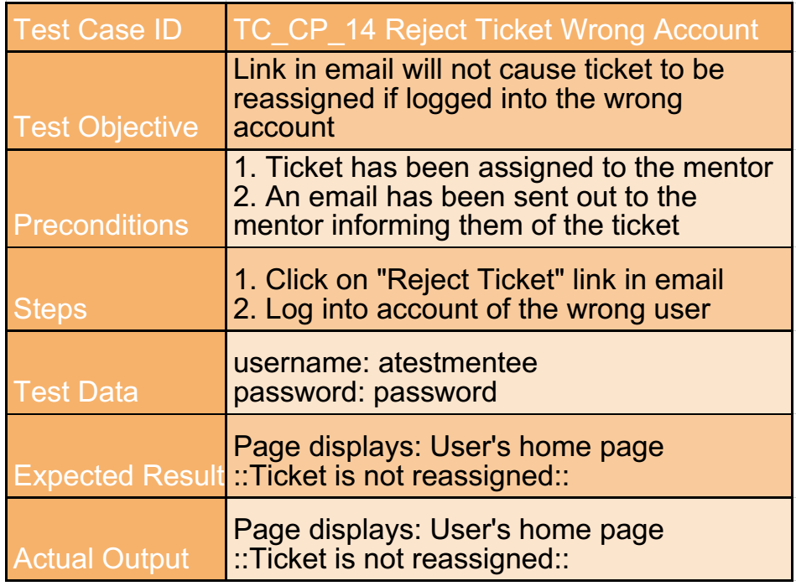
Test Cases

Slide 23
Demo
http://cp-dev.cis.fiu.edu/coplat/index.php/site/login

